Slide 1
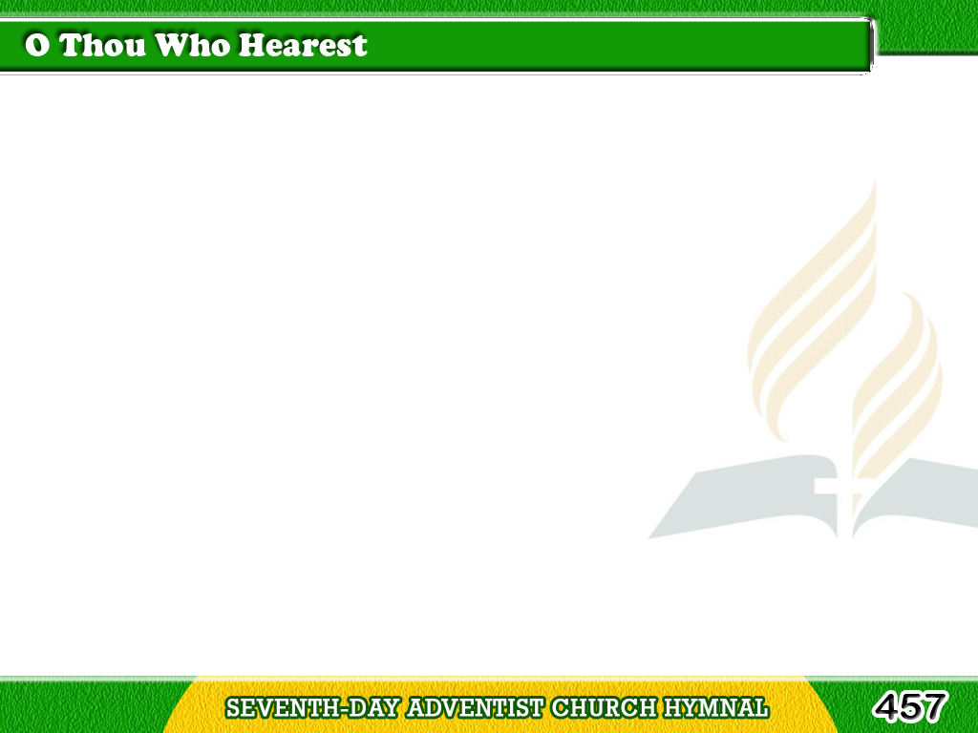
1/1
O Thou who hearest
every heartfelt prayer,
With Thy rich grace,
Lord, all our hearts prepare;
Tagalog
Version

Slide 2
1/1
Thou art our life,
Thou art our love and light,
O let this Sabbath hour with
Thee be bright. Amen.
Tagalog
Version

